Slide 1
Multiple Regression (including Polynomial Regression)
Muhammad Moaz Amin – Summer Semester 2021
Deep Learning

Slide 2
Agenda
Motivation
Introduction
History
Math behind Polynomial Regression
Why do we need Polynomial Regression?
Implementing Polynomial regression with python
Bias vs Variance Trade Off
Conclusion
References

Slide 3

Motivation
“Regression analysis is a form of predictive modelling technique which investigates the relationship between a dependent and independent variable.”
Simplest form of the regression analysis is Linear Regression which has one dependent and one independent variable.
But….
what happens if there are more than one independent variables?
Can linear models be used to fit non-linear data?

Slide 4
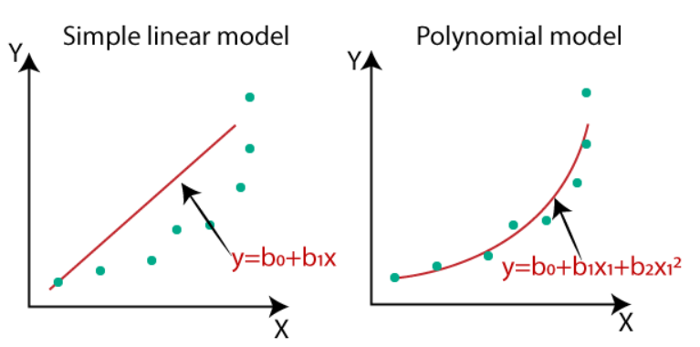
Introduction
What is Polynomial Regression?
Polynomial regression is a type of Multiple regression. It is a special case of linear regression where we fit a polynomial equation on the data with a curvilinear relationship between the target variable and the independent variables.
The number of bends that fit the curve depend on the degree of power. Higher the power, higher will be the bends.

Slide 5

History
The first design of an experiment for polynomial Regression appeared in a paper in 1815 by Gergonne.
In the twentieth century, polynomial regression played an important role in the development of regression analysis with greater emphasis on issues of design and interface.
Recently, polynomial models have been complemented by other methods, with non-polynomial models being more advantageous for certain classes of problems.

Slide 6
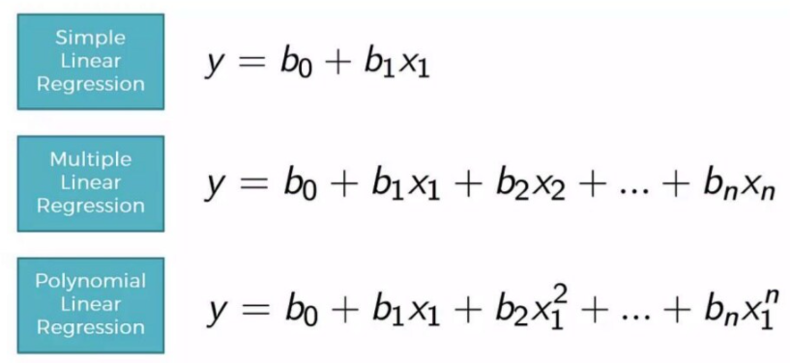
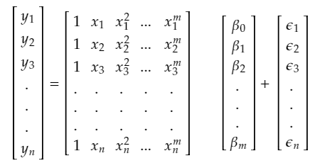
Math Behind Polynomial Regression
Linear Regression is basically the first degree Polynomial.

Slide 7
Why do we need Polynomial Regression?
After creation of our model we find out that it is performing really badly
There is a curve in between the actual value and the plotted line.
Plotted line is not cutting the mean of the points.
What polynomial Regression does?
Polynomial regression predicts the best fit line that follows the pattern of the data.

Slide 8
Implementing Polynomial regression with python

Slide 9
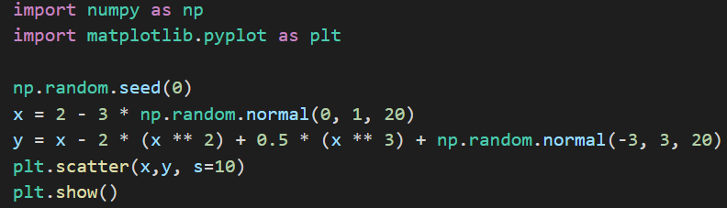
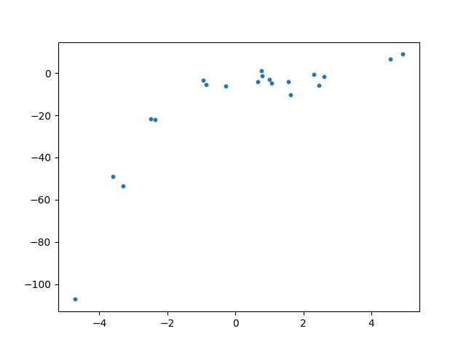
Generating some Random data

Slide 10
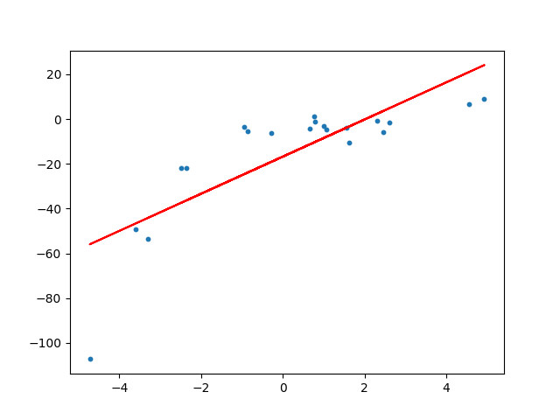
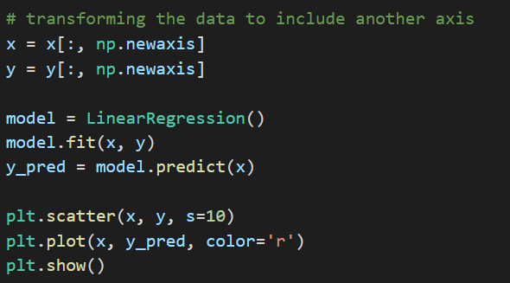
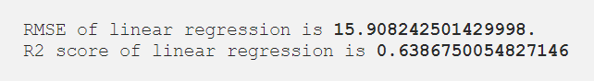
Applying Linear Regression to this Model

Slide 11
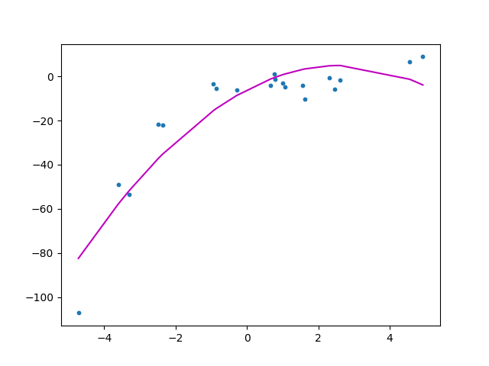
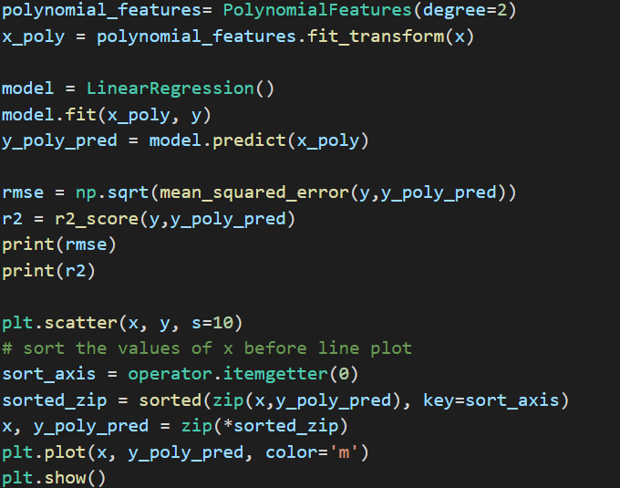
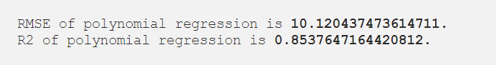
Using PolynomialFeatures Class by scikit-learn(quadratic)

Slide 12
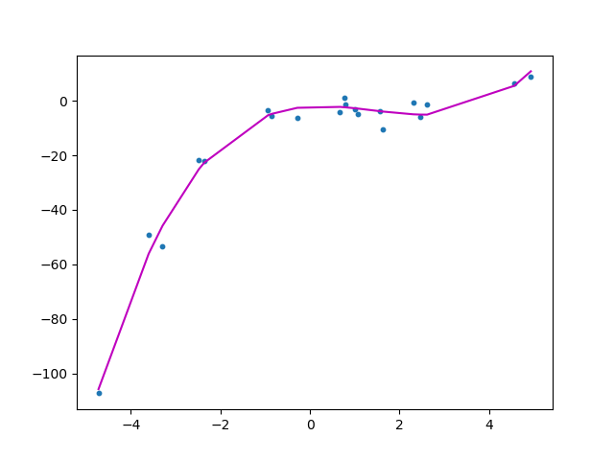
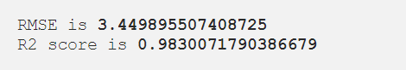
Plot of cubic equation using Polynomial-Features (degree=3)

Slide 13
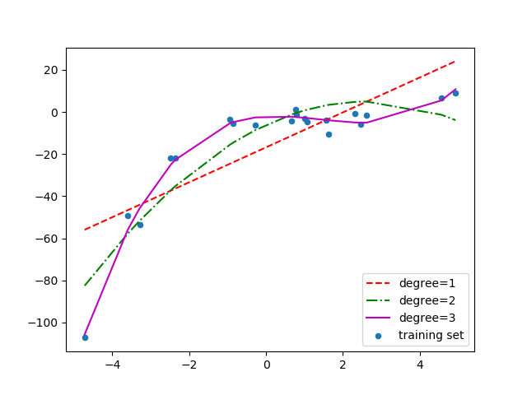
Comparison of linear, quadratic and cubic curves

Slide 14
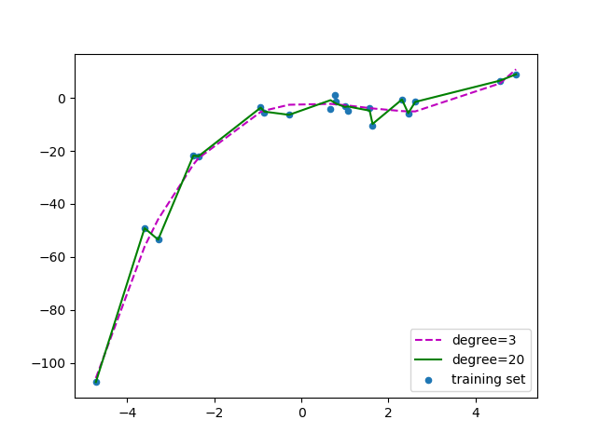
By increasing the degree to 20

Slide 15
Bias vs Variance Trade-OFF

Slide 16
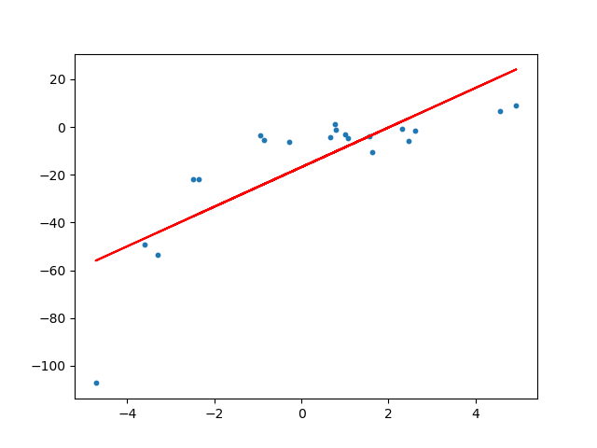
What is Bias?
It refers to the simplifying assumptions made by the model to make the target function easier to approximate.
Higher Bias will result the model not being able to capture the results.
This will in turn cause under fitting.

Slide 17
What is Variance?
It refers to the amount that the estimate of the target function will change given different training data.
Higher variance will mean that the model passes through most of the data points.
it will result in over-fitting of the data.

Slide 18

How to counter Bias and Variance?
Ideally, a machine learning model should have low variance and low bias.
Practically impossible to have both.
For achieving a good model a trade off is made.

Slide 19
Conclusion
Polynomial Regression provides best approximation.
Broader range of function.
Polynomial basically fits a wide range of curvature.
It is very sensitive to outliers.
Presence of outliers can seriously effect the overall result of analysis.
There are less number of tools present to detect outliers.

Slide 20
References
https://hbr.org/2015/11/a-refresher-on-regression-analysis
https://towardsdatascience.com/introduction-to-linear-regression-and-polynomial-regression-f8adc96f31cb
Luca Massaron. Regression analysis with python: Nook book, Feb 2016.
https://towardsdatascience.com/polynomial-regression-bbe8b9d97491
https://gunjanagicha.medium.com/regression-analysis-3417d077a3d3
https://gist.github.com/animesh-agarwal/d8d6a68c1e5a2d5db265d6feb2b39765#file-data-set-py
https://gist.github.com/animesh-agarwal/7a14800809251c590bc735b1817361cd
https://gist.github.com/animesh-agarwal/3d3e85d3a8b2a6deeb8539af5d4ef5cb#file-polynomial-regression-py
Scott Fortmann-Roe. Understanding the bias-variance tradeoff.

Slide 21
THANK YOU

